Slide 1
mAb for the treatment of cancer
mAb for the treatment of cancer

Slide 2
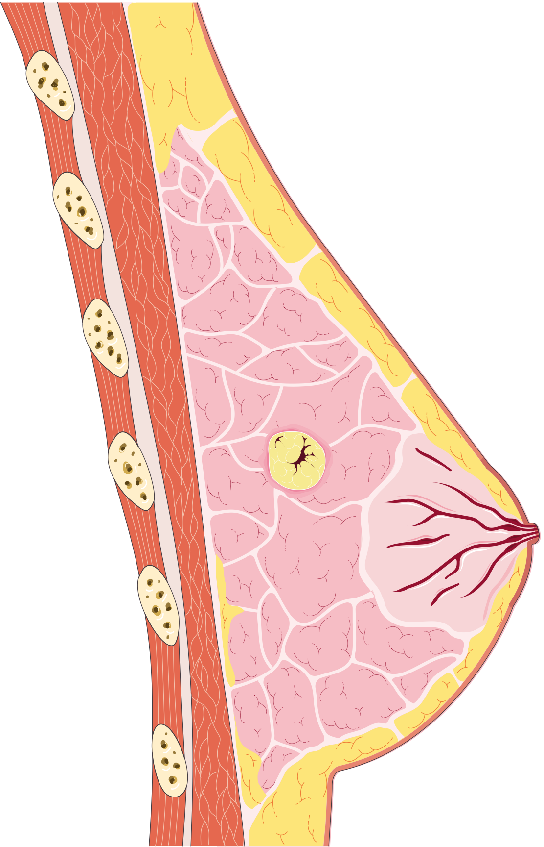


From gene to disease
We can imagine an abstract idea of a tumor growing within tissue.
The key is to ask how it occurs.

Slide 3


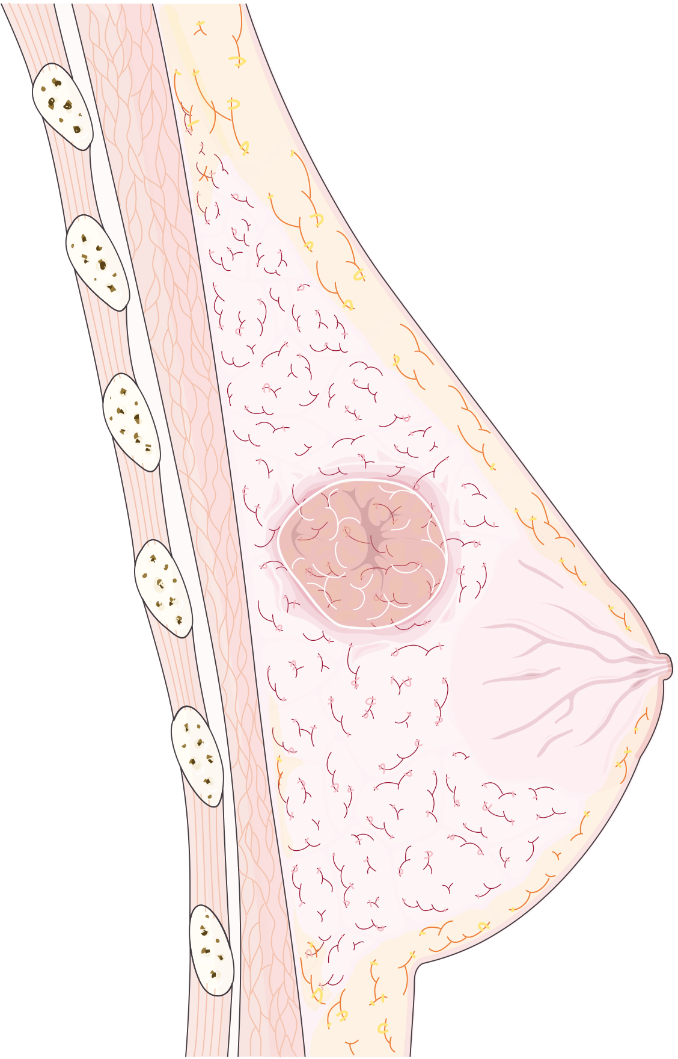
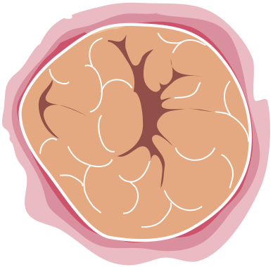
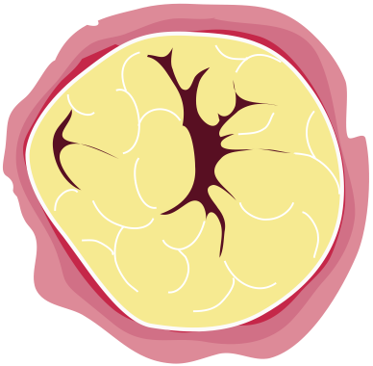
From gene to disease
Every cell must live and grow according to its genetic and environmental constraints.
Any cell has the potential to either respond too little or too much.
We wish to find the underlying cause.

Slide 4
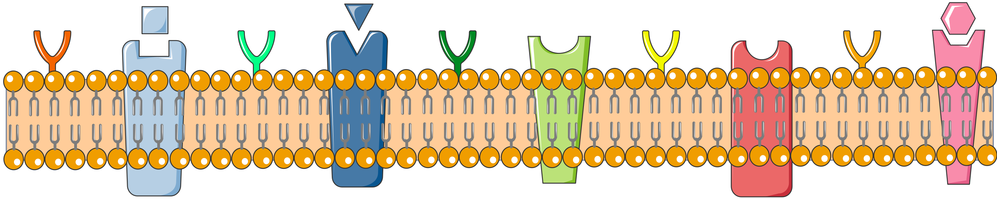
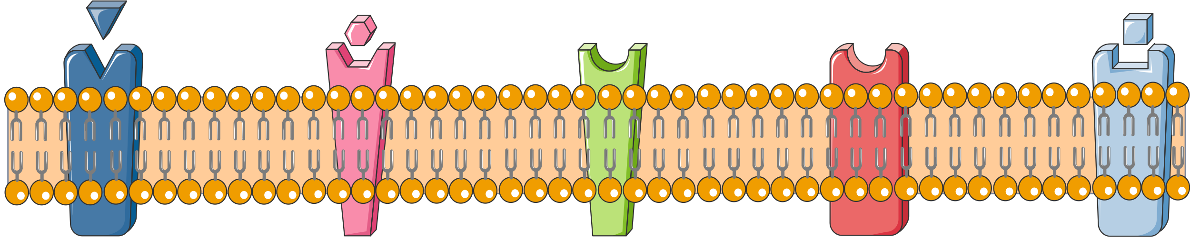
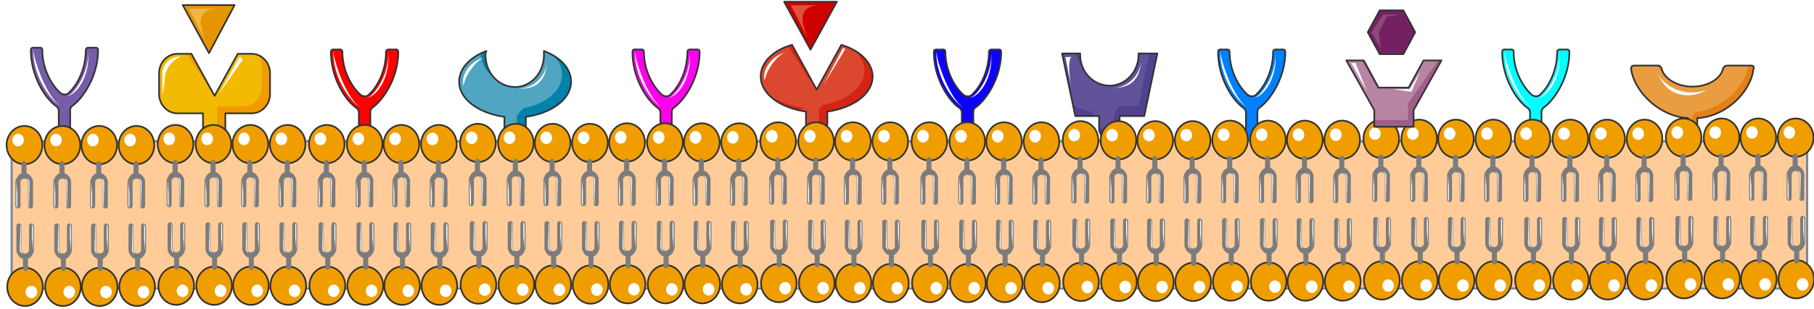
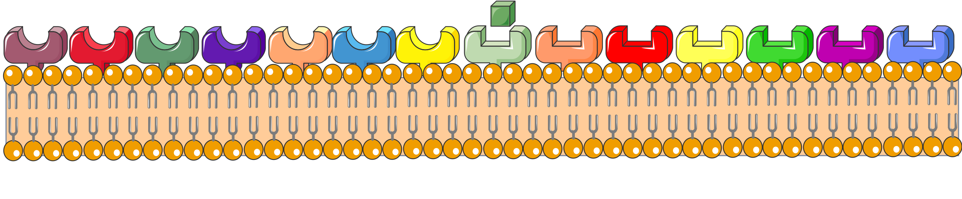
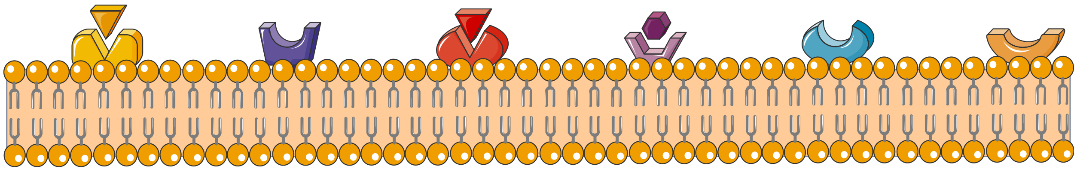
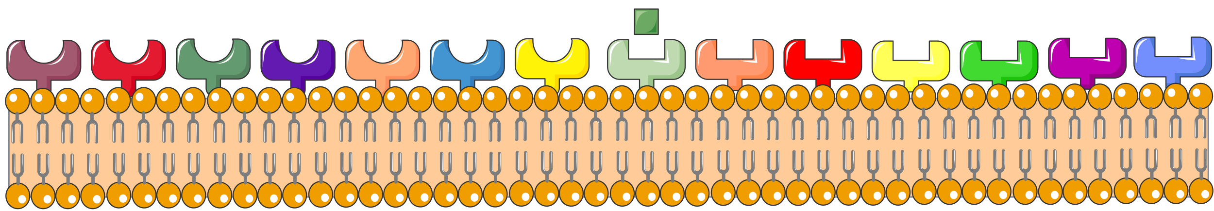
From gene to disease
Every cell consists of hundreds of surface-embedded proteins.

Slide 5
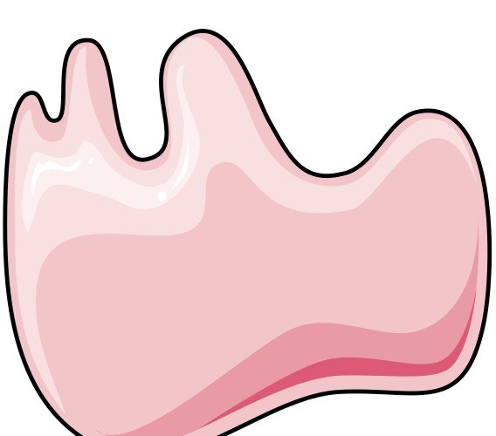













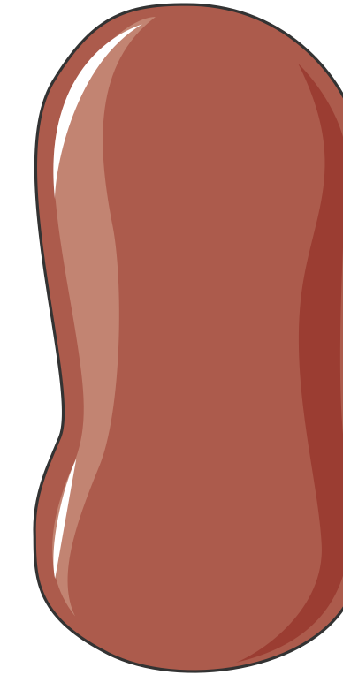






From gene to disease
Stimulation of these surface receptors
propagates a chain reaction into the cell,
to evoke a response.

Slide 6
From gene to disease
There are countless ways that the signal is transmitted.
Each pathway has unique characteristics.
Although, to know one is to know all.

Slide 7
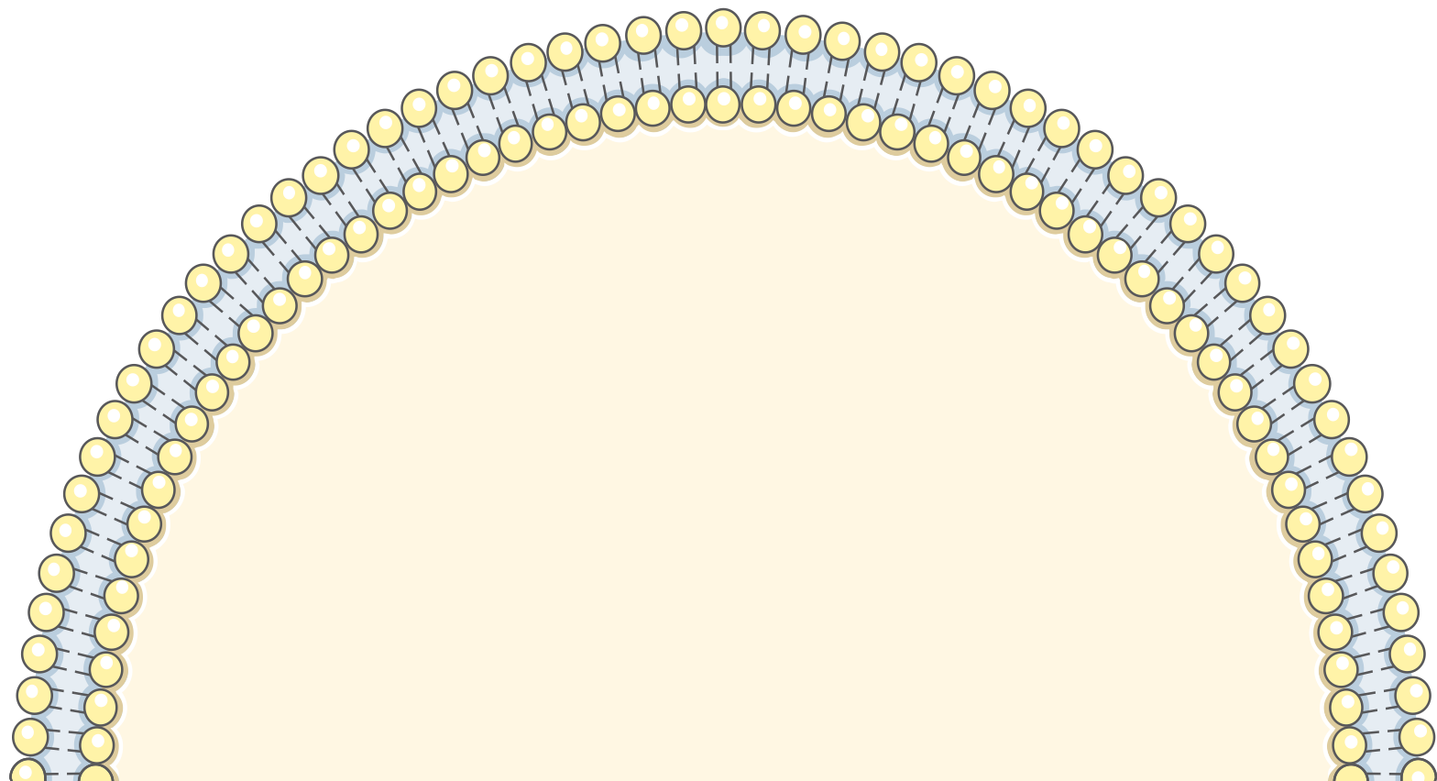
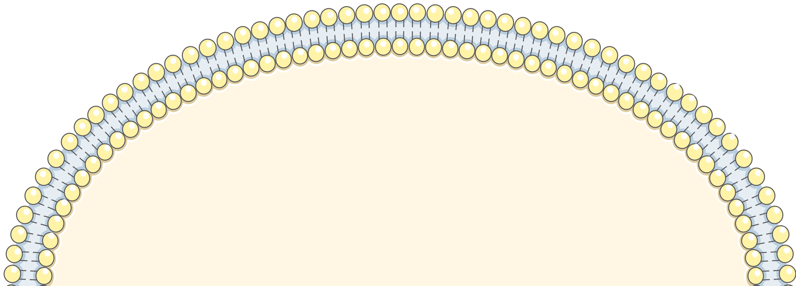
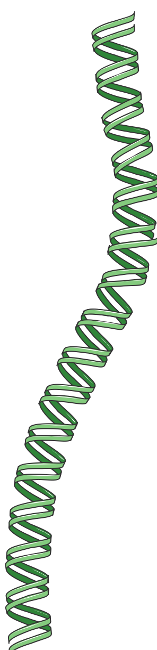
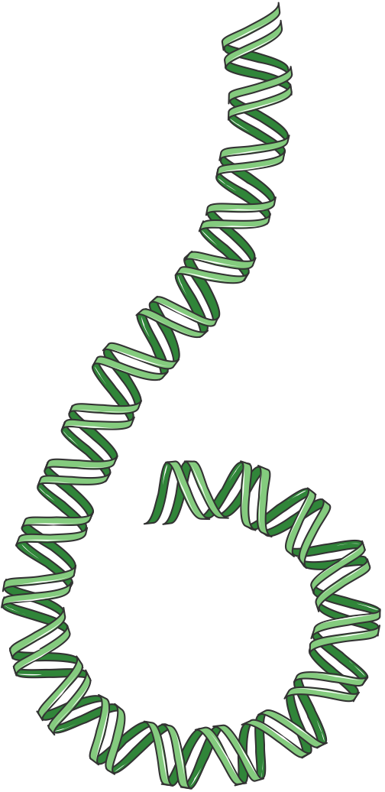
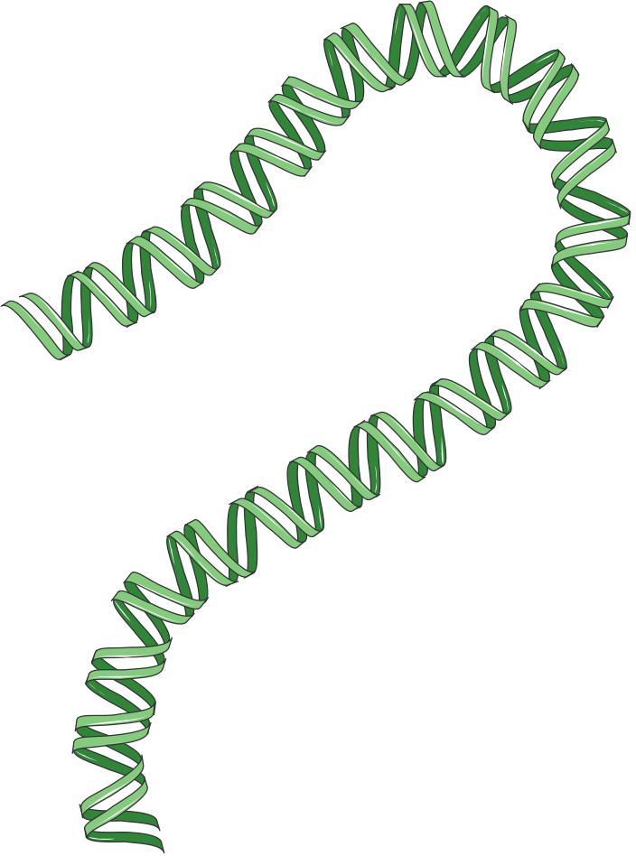

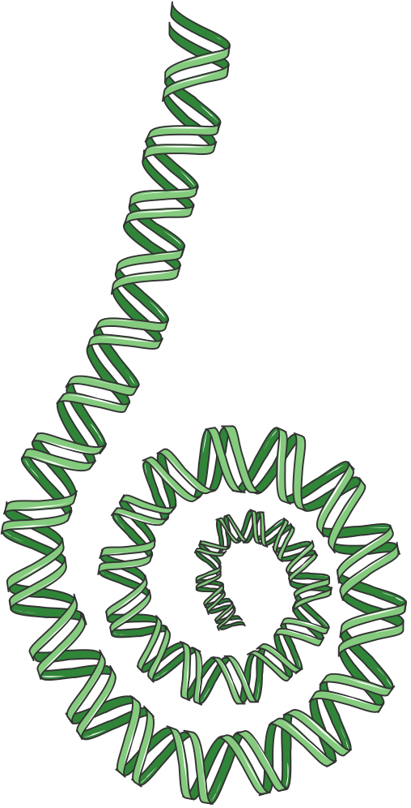
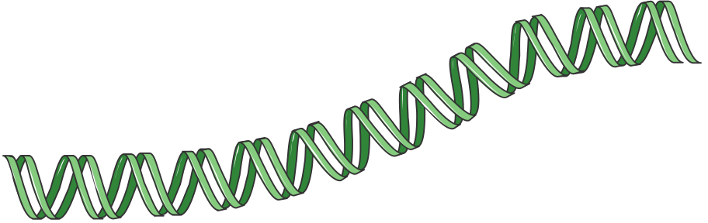


From gene to disease
Whatever the process,
a signal may cause genes in a pathway
stimulation or
repression

Slide 8
From gene to disease

Slide 9
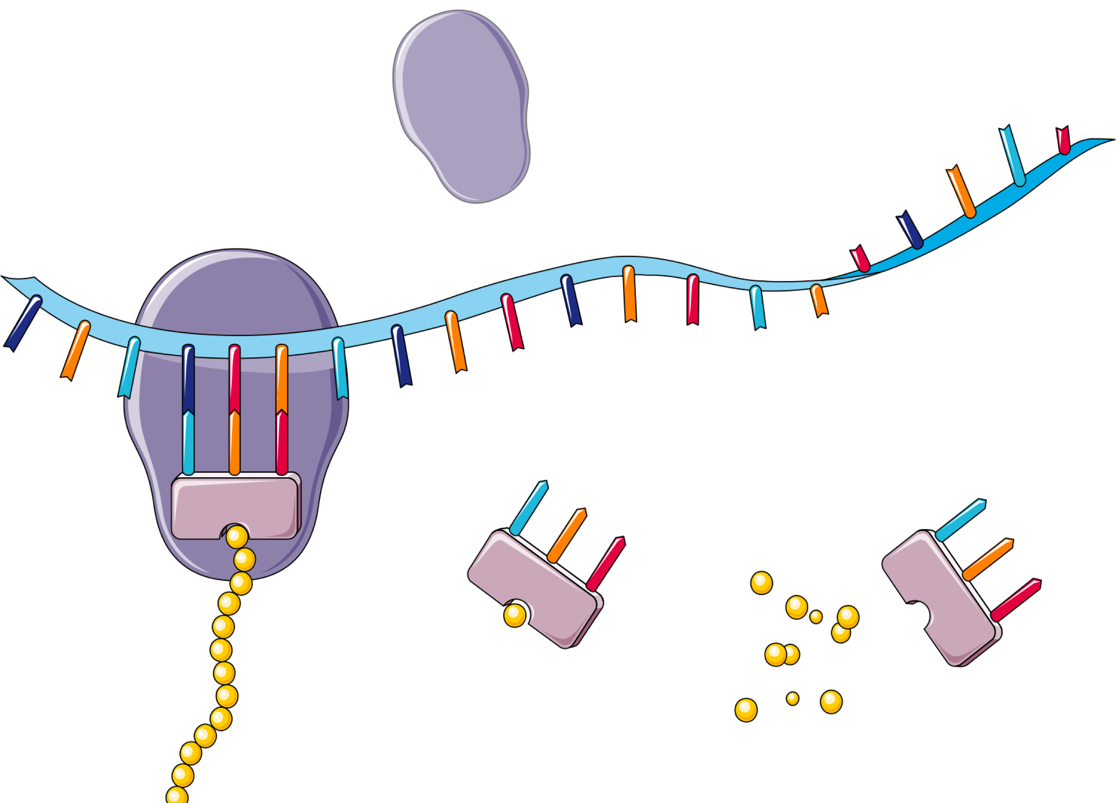
From gene to disease
“Stimulated genes” result in translation into mRNA
And thus into protein.
DNA
(nucleus)
RNA
(cytoplasm)
Ribosome
Polymerase
Protein

Slide 10
From gene to disease
Overexpressed or stimulated gene.
Transcribed into RNA.
Translated into protein.
Overexpressed protein surface receptor.

Slide 11
Targeted treatment
HER2 positive breast cancer.
Caused by ERBB2 gene amplification
that results in overexpression of HER2.
Approximately 15-30% of
breast cancer tumors.

Slide 12
Targeted treatment
Instead of trying to kill of tumor cells
using radiation or chemotherapy,
we can bind a protein to that receptor
to stop if from causing the “growth” signal.

Slide 13
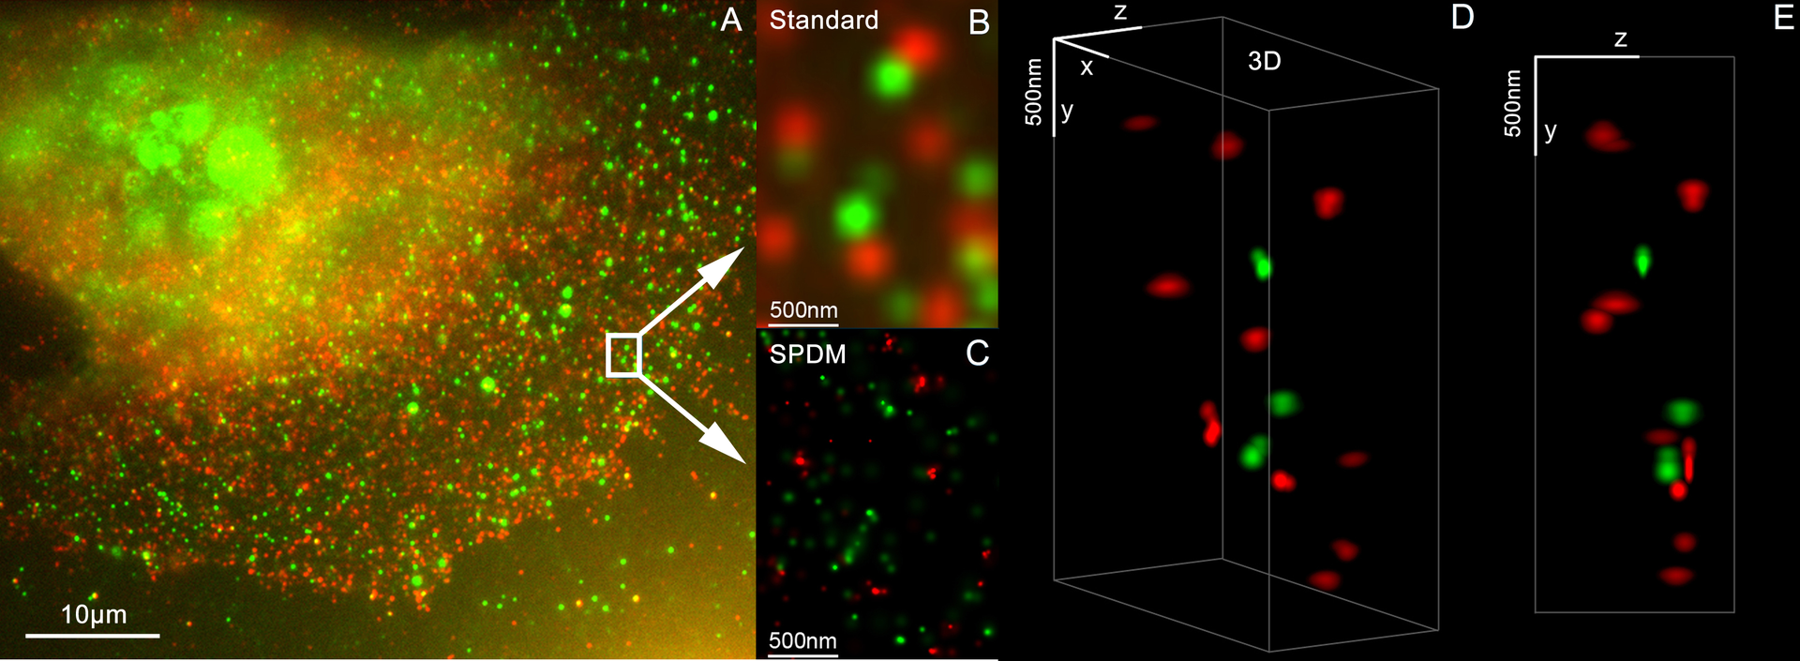
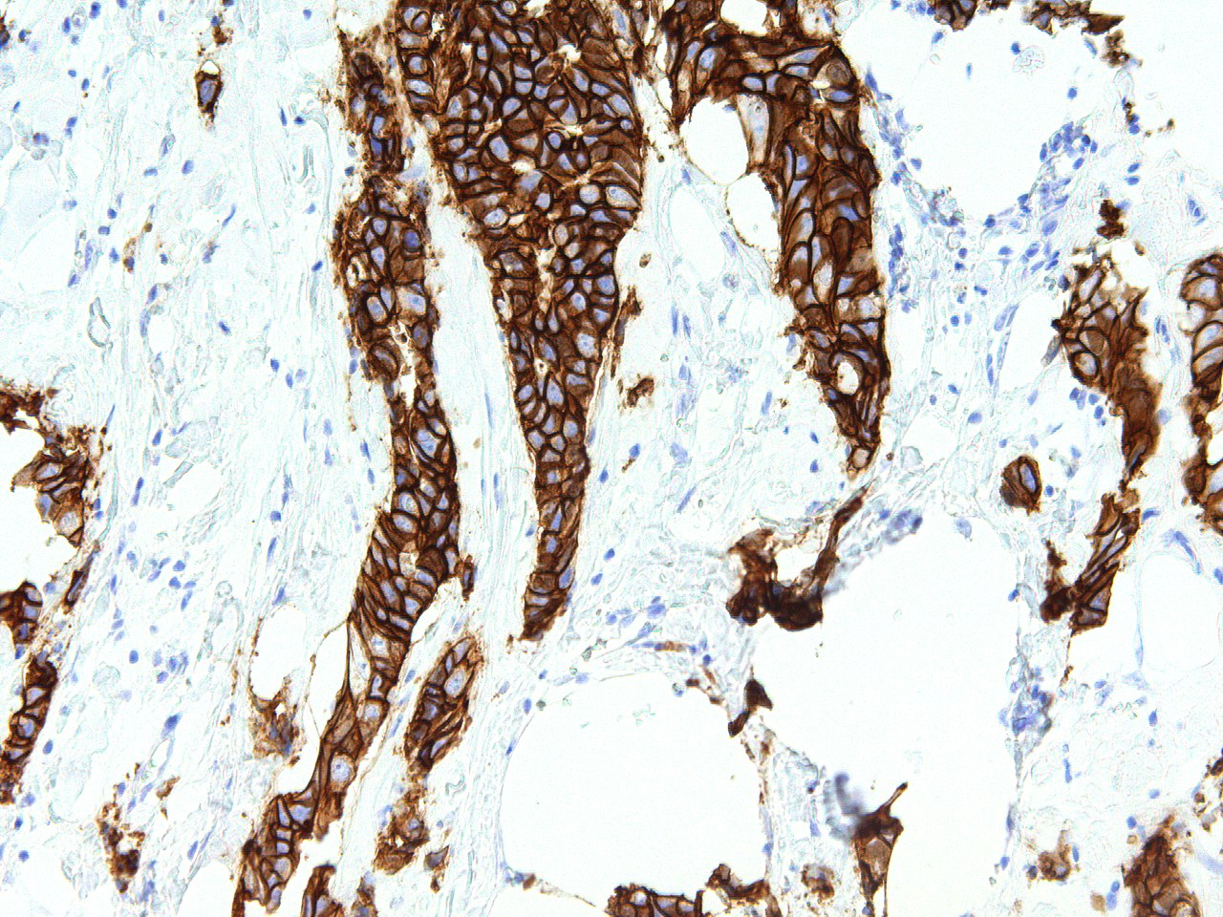
Targeted treatment
First, we confirm that overexpression really is occurring.
Figure 1. Her2 and Her3 distribution on a breast cell, (3D Dual Colour Super Resolution Microscopy SPDMphymod / LIMON, marked with Alexa 488 and 568). Andy Nestl CC BY-SA 3.0. Figure 2. Her2 staining on patient breast cancer tissue identified as stage 3. GenomeMe Lab Inc. - http://www.genomeme.ca/molecular-pathology/Her2-Neu.html CC BY 4.0

Slide 14
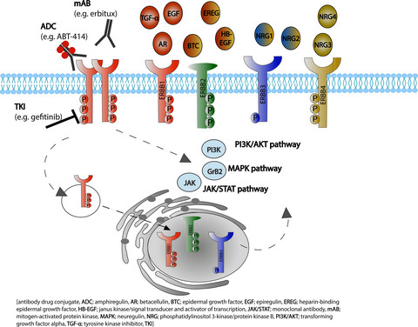
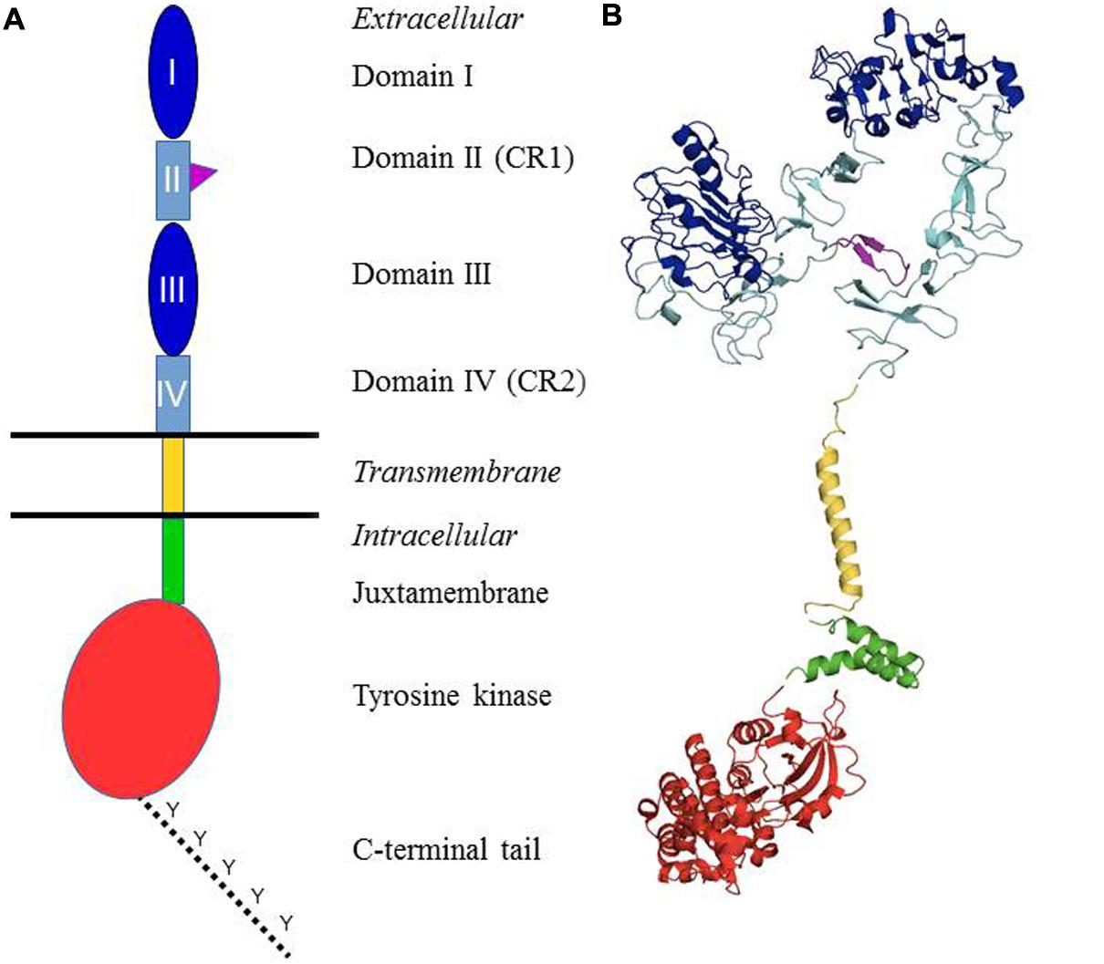
Targeted treatment
Second, we want to target a part of the protein that is on the surface.
Figure 1. von Achenbach, C., Weller, M. and Szabo, E. (2018), Epidermal growth factor receptor and ligand family expression and activity in glioblastoma. J. Neurochem., 147: 99-109. https://doi.org/10.1111/jnc.14538
Figure 2. Appert-Collin, et. al. Role of ErbB Receptors in Cancer Cell Migration and Invasion. Front. Pharmacol., 24 November 2015 Sec. Pharmacology of Anti-Cancer Drugs https://doi.org/10.3389/fphar.2015.00283

Slide 15
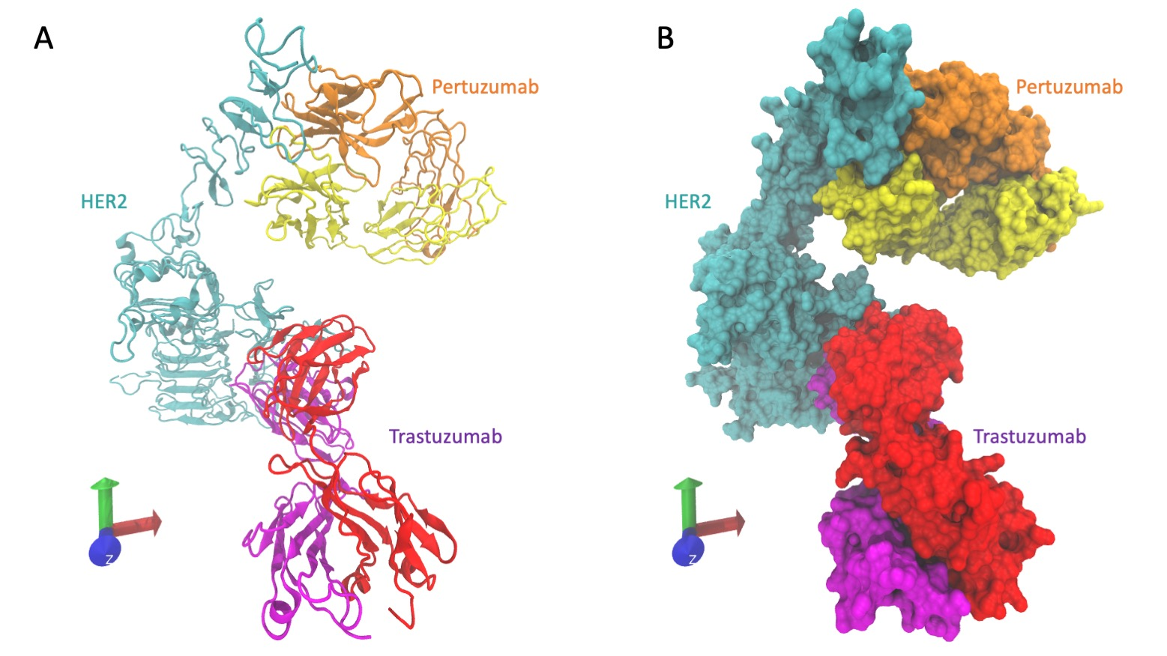
Targeted treatment
Third, we “raise” an antibody which can bind to this target.
Figure 1. Cryo-EM structure of HER2 (cyan) extracellular domain, Trastuzumab Fab (Herceptin - red and pink), and Pertuzumab Fab complex (Perjeta - yellow and orange). Derived from PDB 6OGE https://doi.org/10.1371/journal.pone.0216095.

Slide 16
Trials and market
Fourth, we test the efficacy, safety, etc.
We follow
Guidelines
Regulations
Mandates

Slide 17
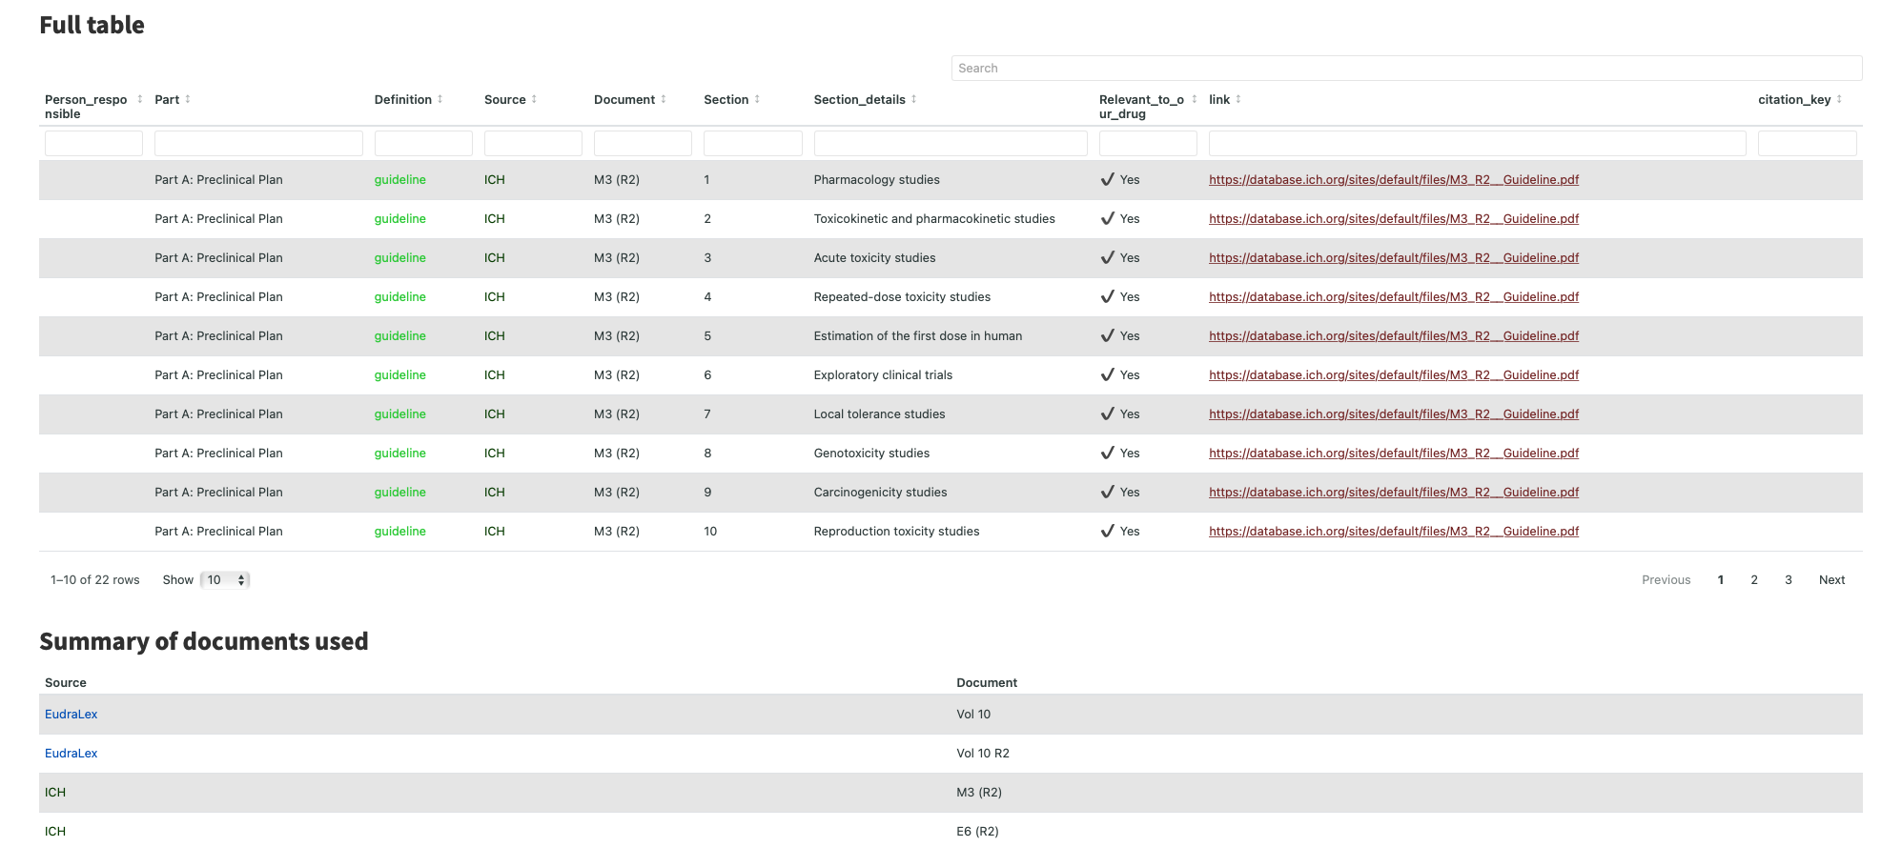
Trials and market

Slide 18
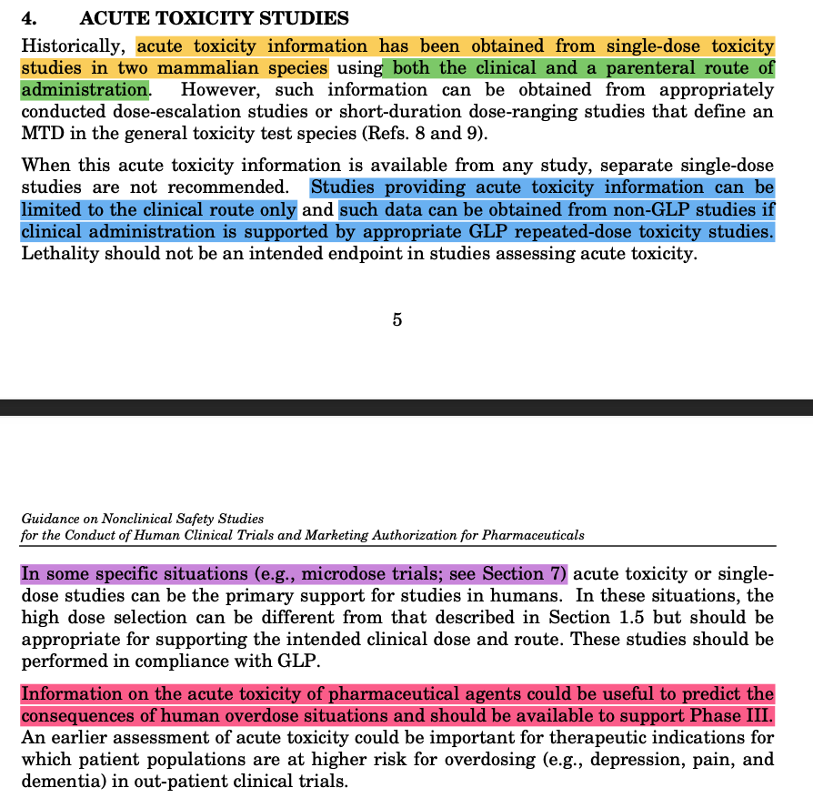
Trials and market
Example
Acute toxicity has been assessed using single-dose toxicity studies in two mammalian species (one non-rodent);
mammal one - acute_toxicity_study_report_one.pdf
mammal two - acute_toxicity_study_report_two.pdf
In these studies, both the clinical and parenteral route of administration was used (intravenous). Successful outcomes were obtained in both studies. The minimum and maximum dosages (3 - 18 mg/kg) were administered over 90 minutes without short-term adverse effects
Each study was conducted under GLP.
These acute toxicity results will be used in combination with the known toxicity for other mAbs to assess the potential consequences of human overdose and will be available to support Phase III.
Notes:
ICH guideline section 4 for Part A. Preclinical studies.

Slide 19
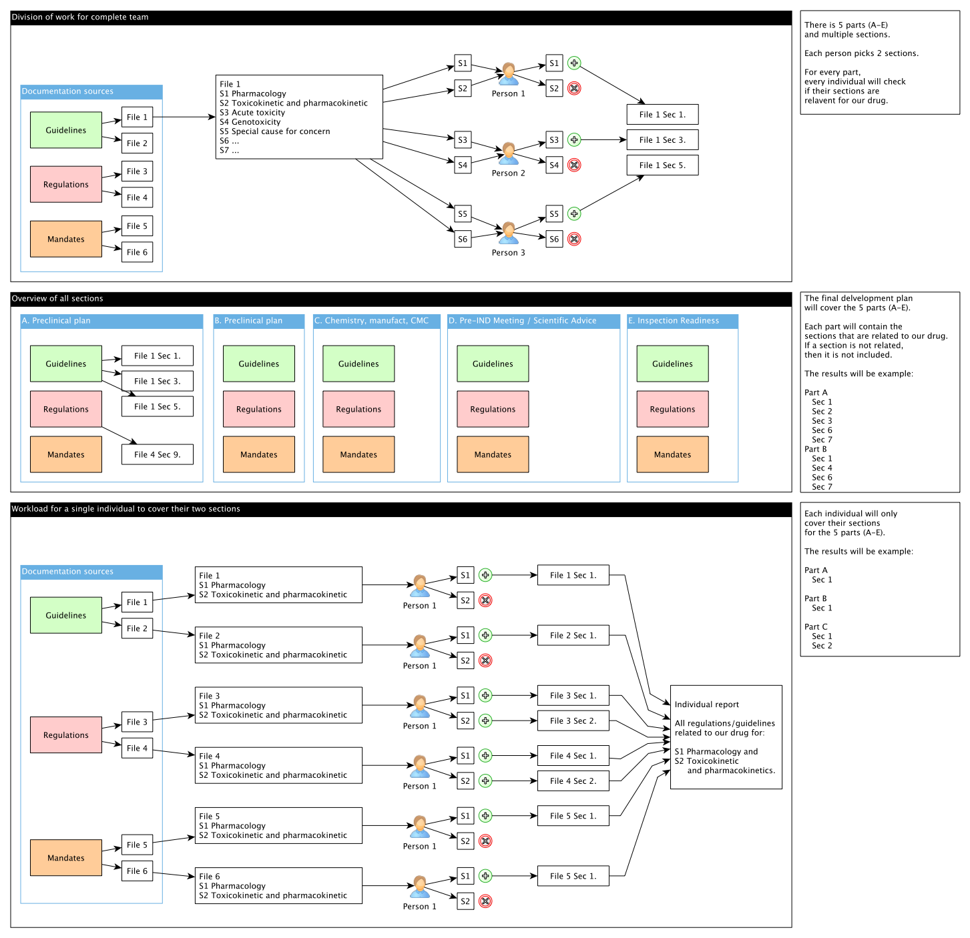
Trials and market

Slide 20
Final report
There are approximately 15 sections.
Pick 2 sections.
For each guideline, go to your section.
Re-write out the paragraph about how the guideline/regulation was fulfilled.
This is your individual report.
Everyone will have the same report except covering different sections.
The group report is the compiled version of all sections.

Slide 21
Final report
Individual report 15/10/22
Group report 10/11/22
Same layout as the drug development plan:
product_description_group_C_mAb.pdf
We track all material on
regulation_table.csv

